Slide 1
L6 Group 1
Amy Potter
Daniel Pokladek
Notes:
So i dont forget: Presul’s daily tasks?

Slide 2
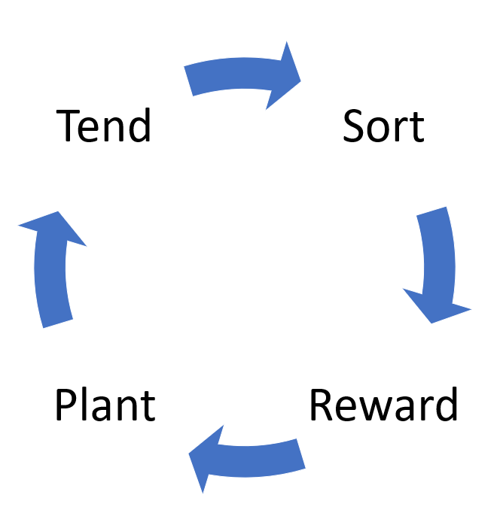
Core Game Loop
Notes:
Amy: As shown in the prototype, players are presented with an object in the middle of the screen. They must drag this object into the appropriate category, which will drain their energy by one. As an element of progression, players will be able to unlock further categories and objects to sort, which will allow them to obtain more rewards.
In order to continue sorting, players are encouraged to harvest their plants in order to gain stars and replenish their energy. In order to prevent players having to wait for a long time, the energy replenishes itself over time. However, the energy via this method is lower in value and thus is a suboptimal choice over growing and harvesting plants.
Over time, sorting and planting objects will become less of a priority for the player as their planet begins to look the way they envisioned. To encourage the player to continue playing, we have considered the integration of tending mechanics, such as pruning and watering, which will offer the player new rewards.
As shown in the prototype, players are presented with an object in the middle of the screen. They must drag this object into the appropriate category, which will drain their energy by one. As an element of progression, players will be able to unlock further categories and objects to sort, which will allow them to obtain more rewards.
In order to continue sorting, players are encouraged to harvest their plants in order to gain stars and replenish their energy. In order to prevent players having to wait for a long time, the energy replenishes itself over time. However, the energy via this method is lower in value and thus is a suboptimal choice over growing and harvesting plants.
Over time, sorting and planting objects will become less of a priority for the player as their planet begins to look the way they envisioned. To encourage the player to continue playing, we have considered the integration of tending mechanics, such as pruning and watering, which will offer the player new rewards.

Slide 3

Market Psychographic
Mobile platform
Casual game
Daily commute
Gardening, cake decorating and bird watching
2 children and a pet cat called Tigger
Tidy
Patricia, 37 years old
Notes:
Amy: Patricia is a 37 year old woman from Peterborough who commutes to London for work on a daily basis. She enjoys gardening, cake decorating and bird watching during her spare time and uses Pinterest to find interesting recipes that she can experiment with. In addition to her two children, Patricia and her husband have a pet cat called Tigger. The idea of nurturing is important to Patricia as she is an animal lover and is highly eco-conscious. She is also extremely tidy and prefers that her house is meticulously organised is she can help it.

Slide 4
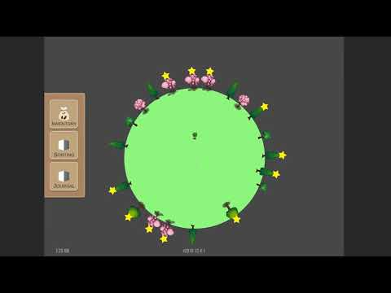
Prototype Video
Notes:
Dan: This is still a prototype scene, in the final game players will start with a blank canvas. We can see the tree slowly growing, and next transition into the sorting screen. From here the players will be able to sort objects into categories to gain rewards, at this moment we have two example categories “Veg” and “Fruit” just to test the system. When players move the item onto the right/wrong category, a energy point is deducted from the player. When the players move the item into the correct category, under the hood, they gain a point. Once they gather enough points, they will be given a reward. For the sake of the prototype, when player sorts 5 carrots, they gain a tree in their inventory. As can be seen on the screen, the player run out of energy and couldn’t sort the object. To regain energy players harvest fully grown trees. Now that we sorted one more item, we have received our tree and we can plant it on our planet and watch it grow.

Slide 5



Appealing to the Psychographic
Casual
Easy to learn
Completion and design
Real world
Surprise
Notes:
Amy: By creating a game that requires casual mechanics such as sorting, we appeal to Patricia since she doesn’t need to develop a new skill in order to play. This means that there is only a short amount of time required to become proficient in play and thus the game can be played without much thought during work breaks, the daily commute or for a moment of relaxation at home.
Since the sorting revolves around extrinsic information based on the real world, there will also be no need for Patricia to learn anything new and thus the game is accessible to her.
Patricia is a particularly tidy person and therefore enjoys bringing order to chaos, which is demonstrated via our sorting mechanic. This, in conjunction with the idea of tending to the environment taps into Patricia’s eco consciousness and enjoyment of gardening, therefore making our game appeal to her through her interests. Drawing on the success of Farmville, our game taps into the idea of signalling; where having a tidy and well-tended planet may be a signal of how responsible you are, which may associated with being a good parent.

Slide 6

Progression and Planet Variation
Variants of rewards
Modularity of assets
Notes:
Following feedback from the last presentation, as well tutor sessions, we began looking at how we could use modularity to create assets and also add variation between players planets. In order to add variation between players, we have been looking into the possibility of having different variants for some of our reward objects, as demonstrated by our Twilight tree. When the player completes a task or activity, they are provided with the opportunity to gain 1 of the 3 possible variants of that reward item, and this will random for each player.

Slide 7
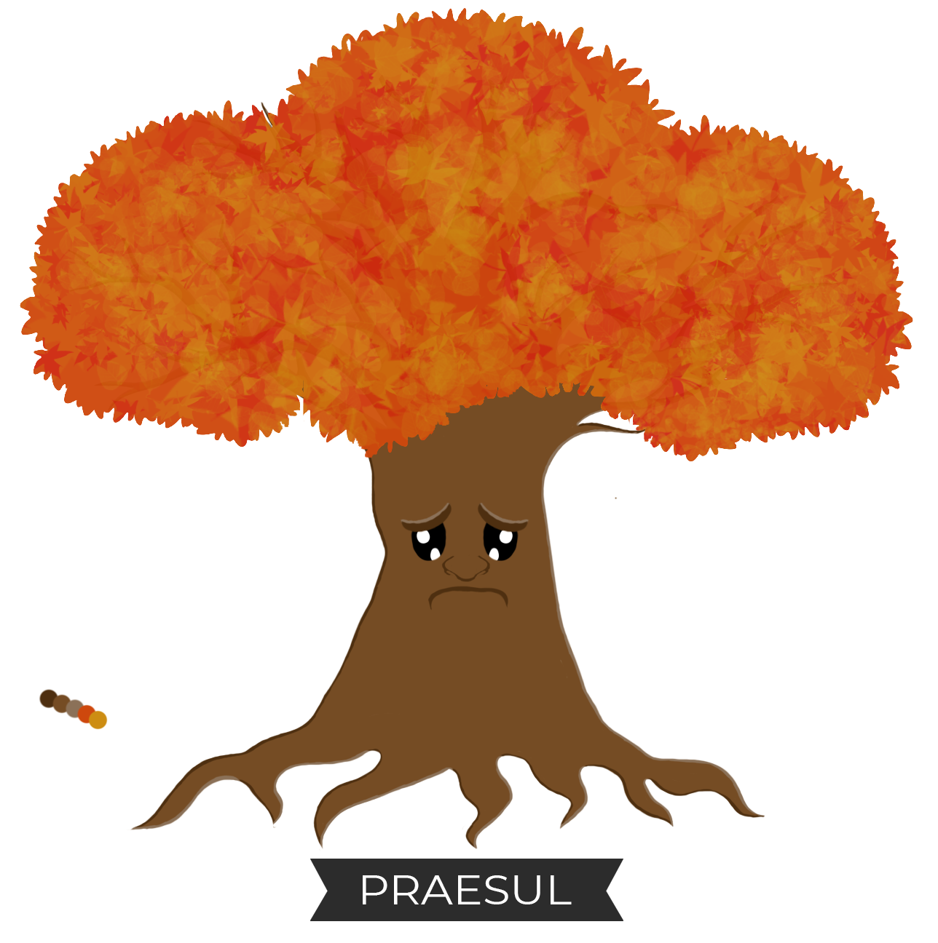
Progression and Planet Variation
Variation in sorting mechanic
Tending mechanics
Praesul’s task system
Snack game
At least 6 hours of gameplay
Notes:
Although our sorting mechanic is very simple in our progression mock-ups, we have considered how we can adjust the mechanic to add variation to it over time. For example, instead of presenting a single item for the player to sort, we could provide them with a pile of 3-4 items that they would need to sort into their categories. A variation of this could be that only certain categories are active for sorting, with categories glowing to show which type of object need to be sorted first.
Initially, sorting and planting objects will be major activities and are likely to become less important as the player fills their planet with the objects that they like. Over time, tending to the objects on their planet will become more important to the player and thus we have considered how we can provide them with opportunities to perform tending activities at various intervals.
We have also introduced the concept of an anthropomorphised tree named Praesul, who will sit at the top of the players planet and provide them with tasks to complete in order to earn unique rewards.

Slide 8
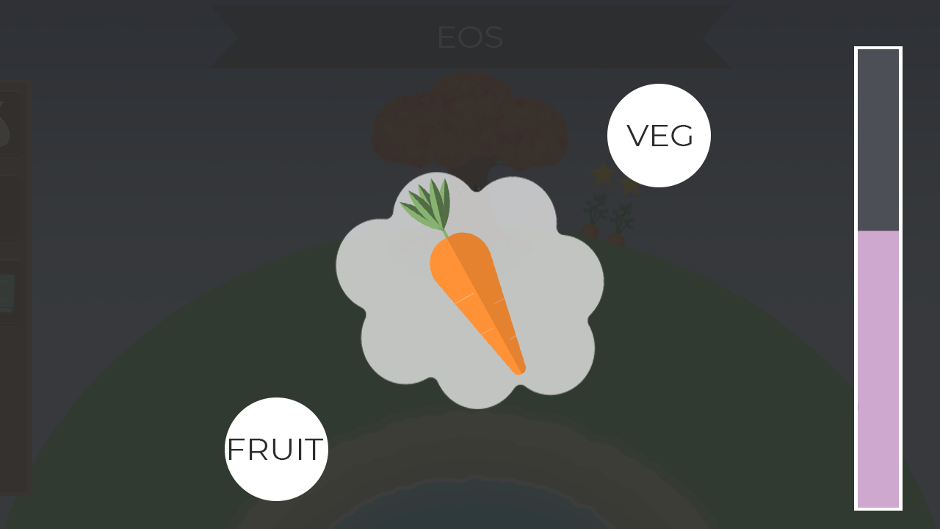
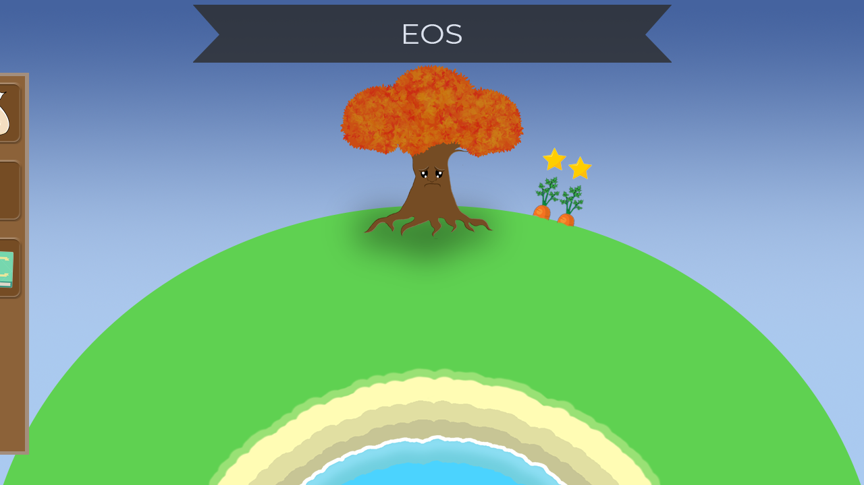
Progression and Planet Variation
5 minutes into the game, after tutorial
Notes:
By the end of first 5 minutes of gameplay, our players would have completed the initial tutorial. From there they would be allowed to explore the game on their own, and decorate their own planet. To start with, players are limited to two categories for sorting and thus will have a limited set of rewards that they can earn. There will be a “sorting points” variable that is invisible to the player which keeps track of how many items they have sorted correctly. Under the hood there is variable that keeps track of how many objects players have sorted correctly; with this variable we keep track of player’s progress, so that we can reward them with new categories and more rewards from sorting. Starting rewards have shorter growth time, compared to late game items, and therefore the player will be able to harvest them and replenish their energy bar quite quickly.

Slide 9
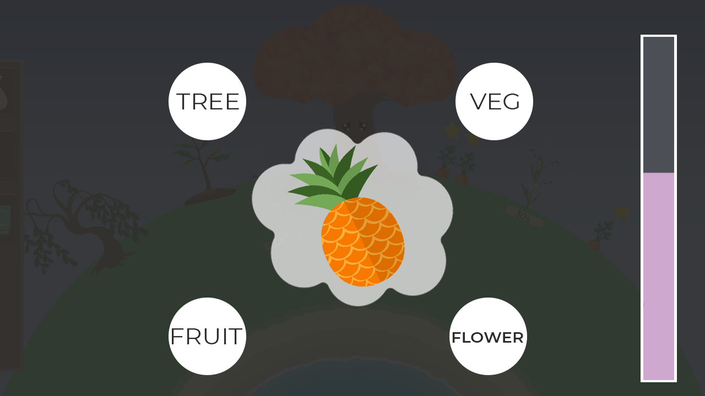
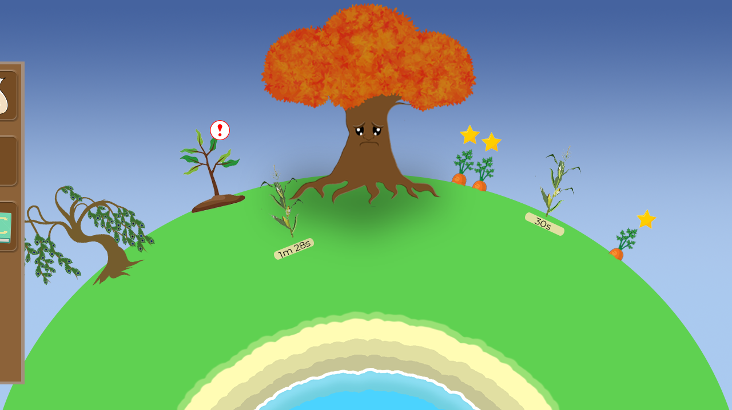
Progression and Planet Variation
1 hour into the game
Notes:
After an hour of gameplay, players will have unlocked further sorting categories, ultimately unlocking the ability to earn further rewards. At this stage, players are likely to have collected some unique rewards from Praesul and can begin customising their planet to make it appear different from other players.

Slide 10
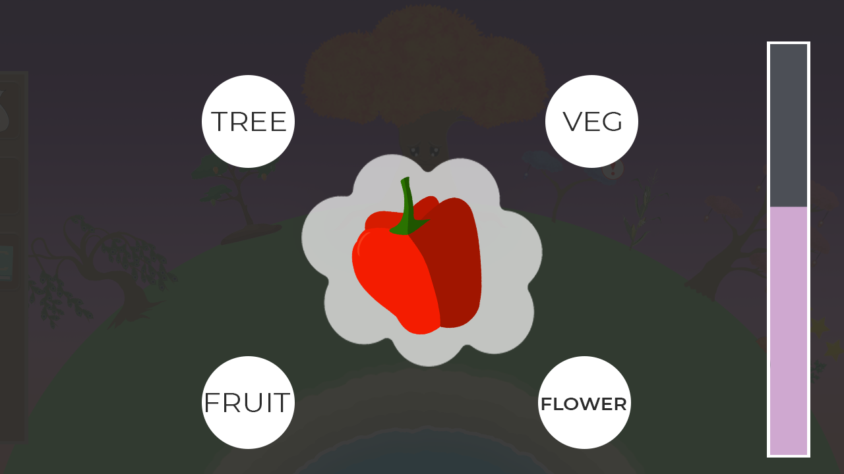
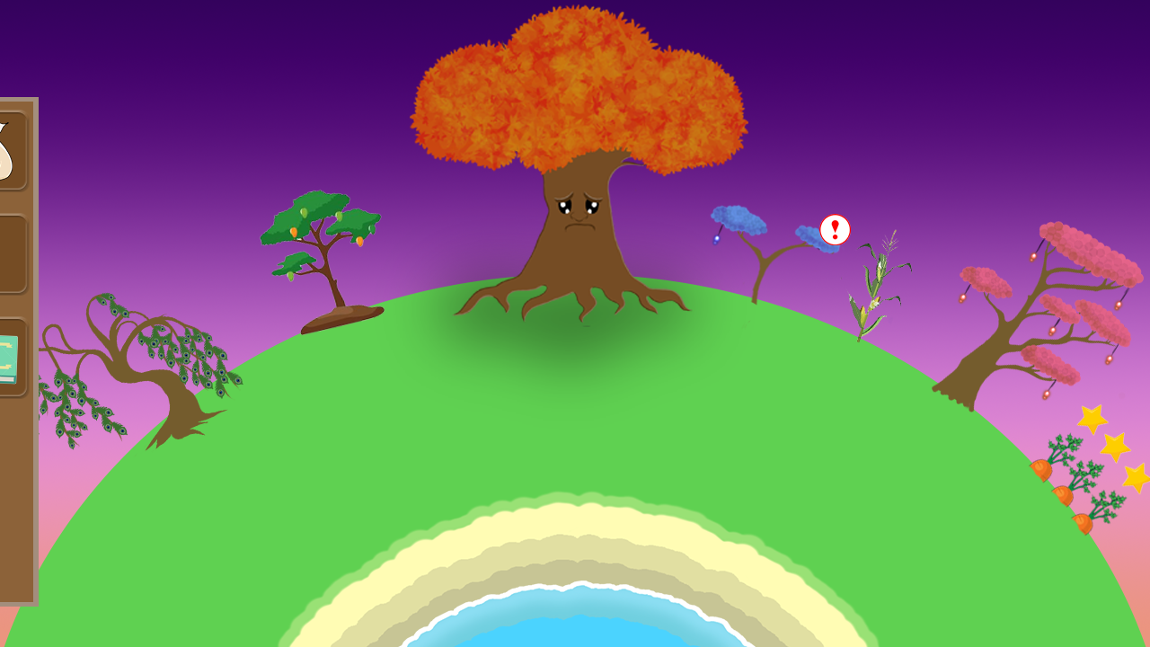
Progression and Planet Variation
6 hours into the game
Notes:
After 6 hours of gameplay, the sorting mechanic will not have changed much since the tending mechanics are likely to become more important to the player. After 6 hours, it is likely that the players planet will be populated with unique rewards that they have earned through completing the tasks that Praesul has set them, or through the tending activities. In order to continue earning rewards, players have a choice of continuing sorting or tending to the objects which are already on their planet by performing activities such as pruning and watering.

Slide 11
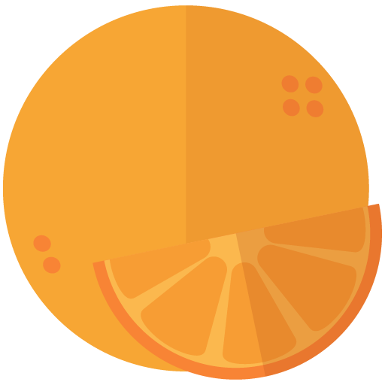

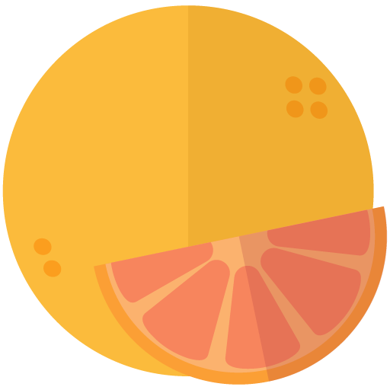

Development
Since last presentation
Approx. 70 hours in last 4 weeks
Progression
Variation
Anthropomorphism
Modularity
Notes:
Over the past 4 weeks, we have completed a combined total of approximately 70 hours of work. This was lower than expected because of time away due to unforeseen circumstances. In this time however, we have made changes to our game revolving around progression, anthropomorphism and variation between players as discussed previously. As well as this, we have been focusing on how we can make our game assets modular in order to reduce the amount of time required to make a vast selection of objects. As you would have seen throughout the slides, we have been focusing on creating variants of both sorting objects and reward objects, using similar anatomy elements from a piece of artwork to create multiple objects at a faster rate.

Slide 12



Key Next Steps
To reach MVP
Continue creating sorting objects
Continue creating rewards
Implement the saving/loading
Continue to refine the progression in the game
Implement the new mechanics
Notes:
Dan

Slide 13
Any Questions?

